Slide 1

Navigating the Research-Driven Marketplace

Slide 2
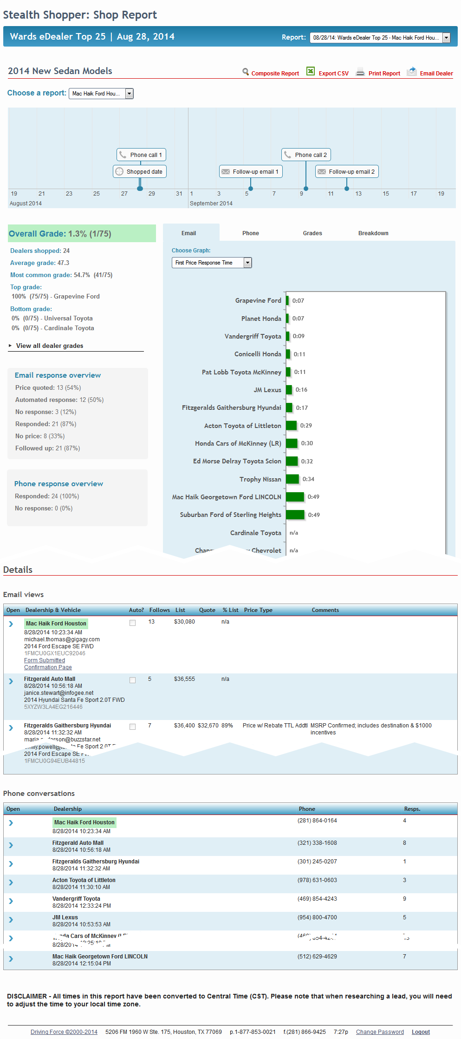
Overview
The Timeline
Stealth Shopper offers you a variety of powerful tools to delve into the “wiring under the board” of your marketing strategy, and the strategies of your competitors.
A day-to-day, minute-by-minute log of all the activity related to your shop.
The Overview Sidebar
A graded overview of the most important data collected from your shop.
The Metrics Panel
Data visualized in chart and graph forms, for at-a-glance performance comparisons.
Email Log
Read every email sent to our mystery shopper’s unique email address.
Voicemail Log
Hear every voicemail left at our mystery shopper’s unique phone number.

Slide 3
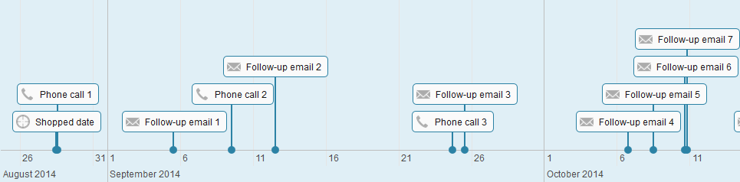
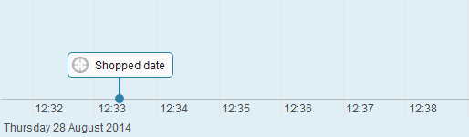
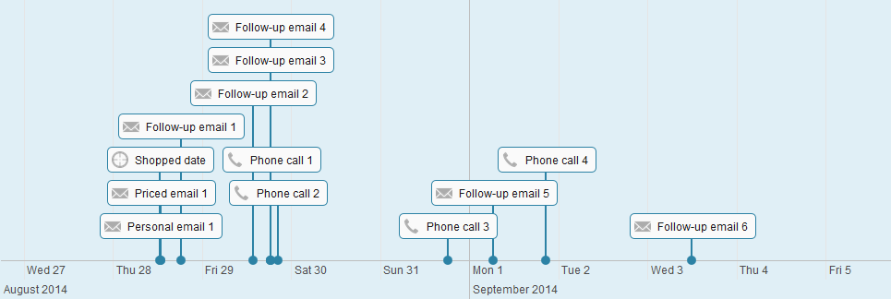
The Timeline
See a good response …
See when the first phone call is made, when the first priced and personalized emails are sent, and how often your sales team follows up on leads.
The timeline allows you to see, at a glance, how quickly and with what frequency your sales team responds to our mystery shoppers.
Zoom in for ultimate granularity.
Need to get a quick look at your first phone call vs. first email response time? Curious about how far apart those phone calls are spaced? Timeline lets you visualize this information with a flick of your mouse’s scroll wheel.
… or a bad response.
Does your sales team pester your customers with phone calls and emails? With the timeline, it’s easy to see clusters of data points at a glance, and you can use that information to help your team pace their responses in a sensible way that won’t scare off potential customers.

Slide 4
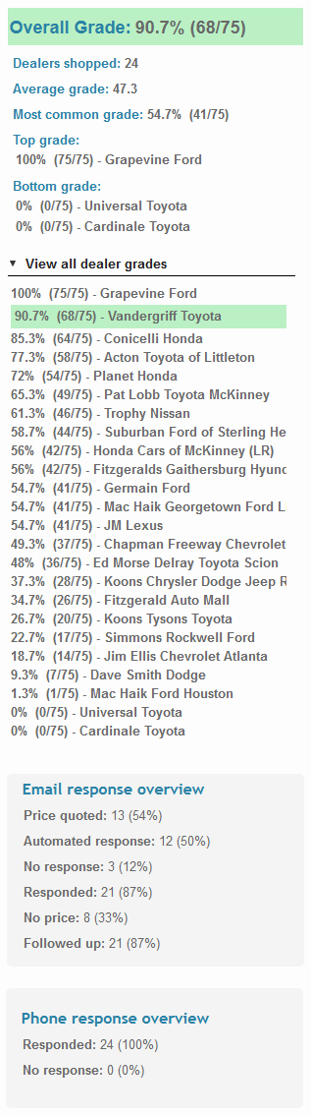
Your Grade.
The Overview Sidebar
The Overview Sidebar gives you the most important details from your shop in broad strokes. You can use it as a starting point for delving into the detailed breakdowns in the Metrics Panel.
Key grades from the entire shop.
See where your grade falls in the curve.
See combined totals and percentages for your most important email and telephone metrics.

Slide 5
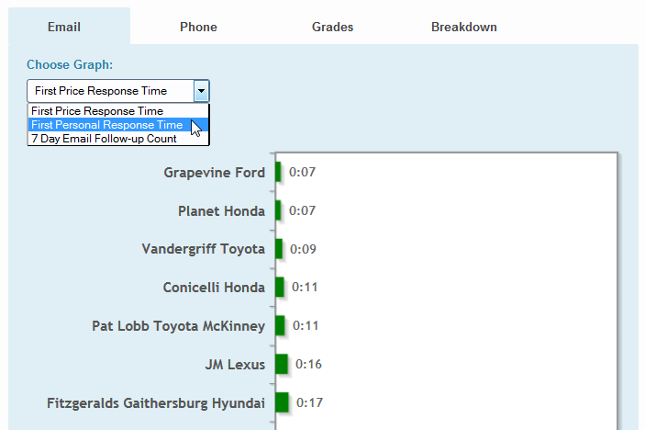
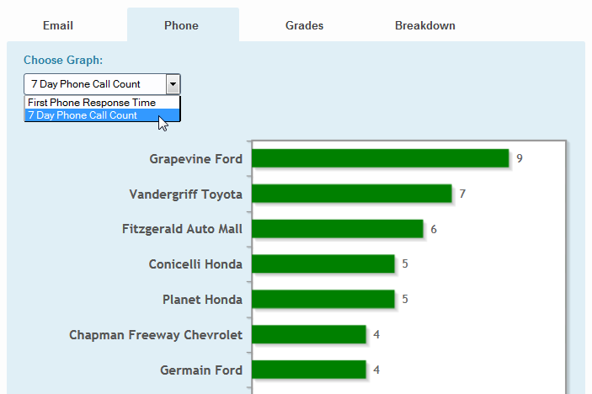
The Metrics Panel
The Metrics Panel provides you with a variety of ways to visualize your shop metrics. Visualization, via charts and graphs, allows you to see how abstract numerical data translates to concrete behaviors.
Email Metrics
Phone Metrics
Our default set of metrics captures the most important aspects of your marketing strategy: First Response Time, First Personal Response Time, and 7-day Email Follow-up Count. You can also add your own custom metrics, tailored to your specific marketing strategy.
By default, we capture First Phone Response Times, and a 7-day Phone Call Count, but you can add as many custom phone metrics as you need to measure the effectiveness of your sales team.

Slide 6
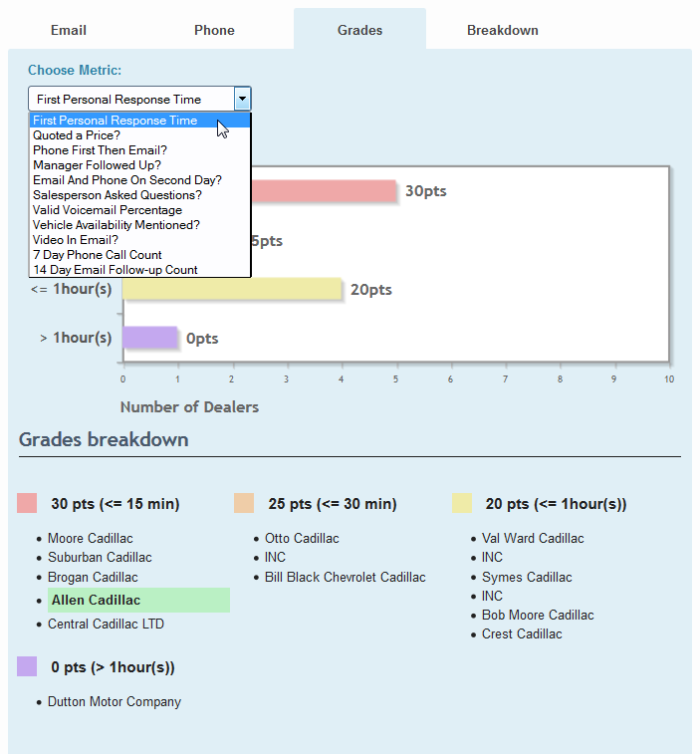
Grades for a wide range of metrics
View a bar graph of grouped grade totals for each of your metrics, and see which dealers fall into each group. You may also add your own custom metrics. Here are just a few custom metrics that we can add to our grading system:
Phone first then email
Manager followed up
Email and phone on second day
Salesperson asked questions?
Valid voicemail message
7-day phone call count
7-day follow-up email
7-day follow-up phone call
14-day email follow-up count
Sales associate name provided
Sales associate title provided
Sales associate phone provided
Sales associate email provided
Dealer differentiator provided
Make and model differentiator
Vehicle availability mentioned
Test drive mentioned
Sales mentioned
Alternative vehicle choice

Slide 7
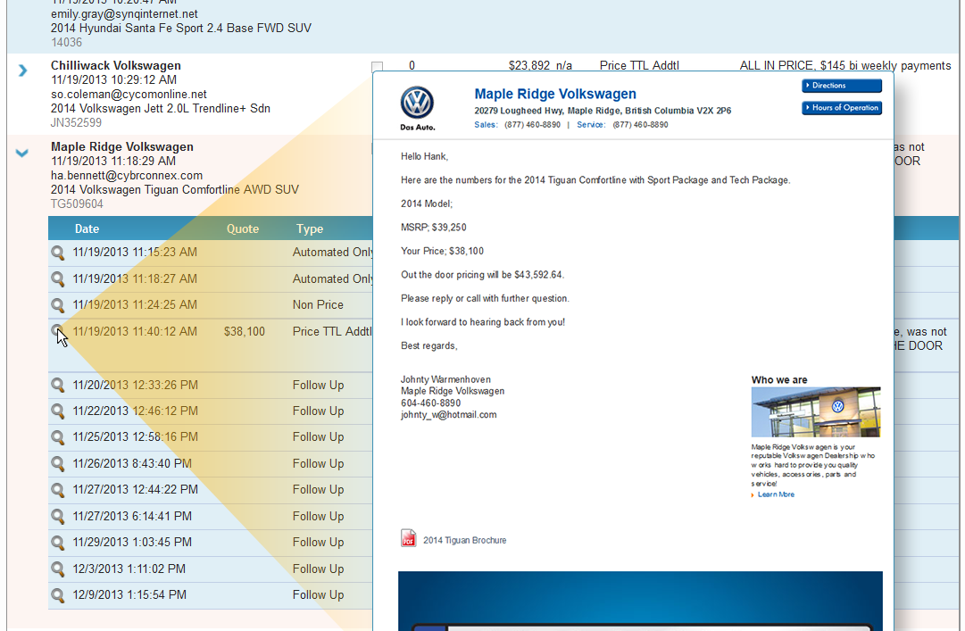
The Email Log
We log a copy of every email sent to our myster shopper’s address. At a glance, you can view key details like send date, price quote and automated or personal response type. With a single click, you can also view the actual email, in its original format, including images, body text, and other features, like similar vehicle suggestions or links to brochures.

Slide 8
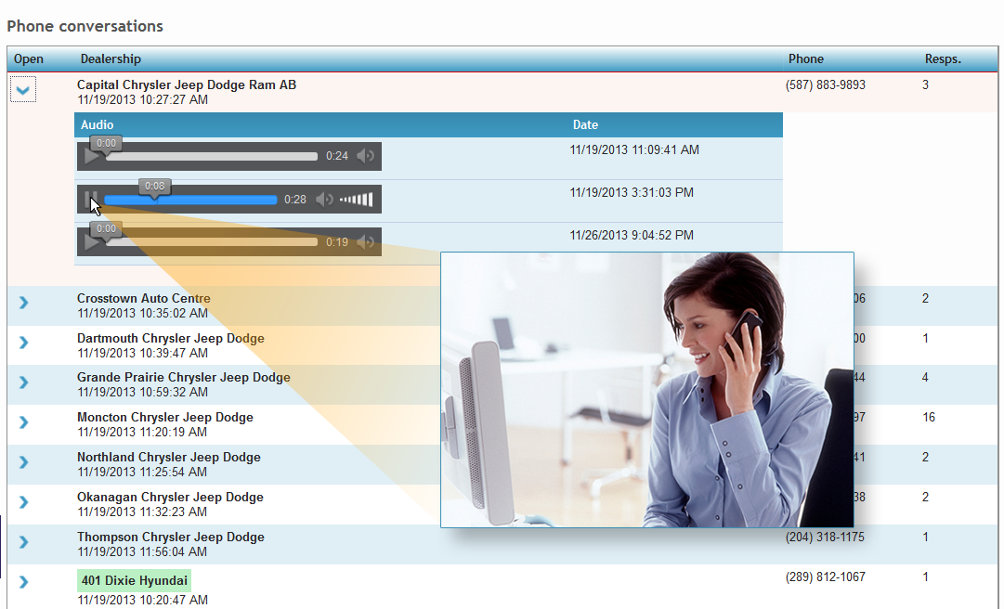
The Voicemail Log
In addition to email, we log an audio file of every voicemail left by a dealership’s sales team. Not only can you see, at a glance, how often a salesperson called our mystery shopper, but you can also view the duration of the call, and hear the salesperson’s message and vocal delivery.

Slide 9
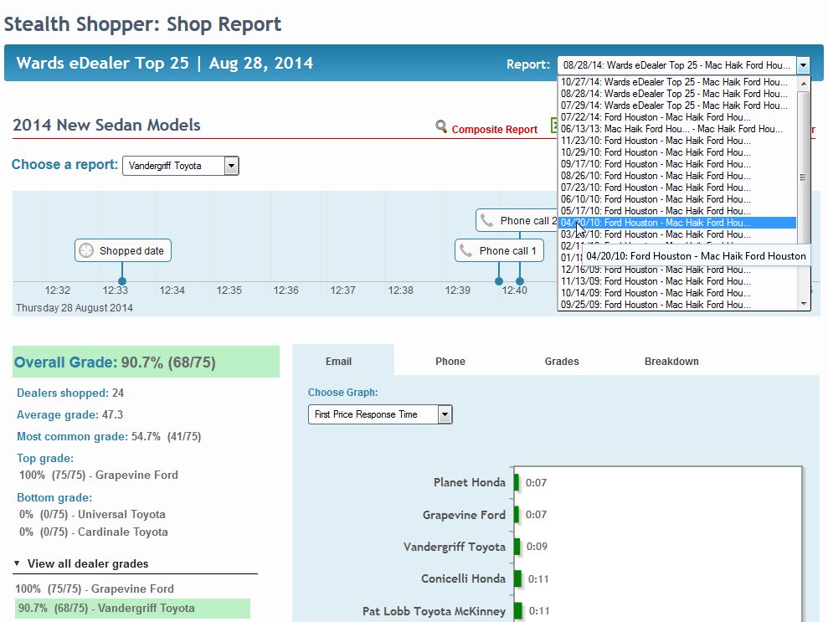
Shops Archive
Access all of your previous shops from the header of any shop you view.

Slide 10
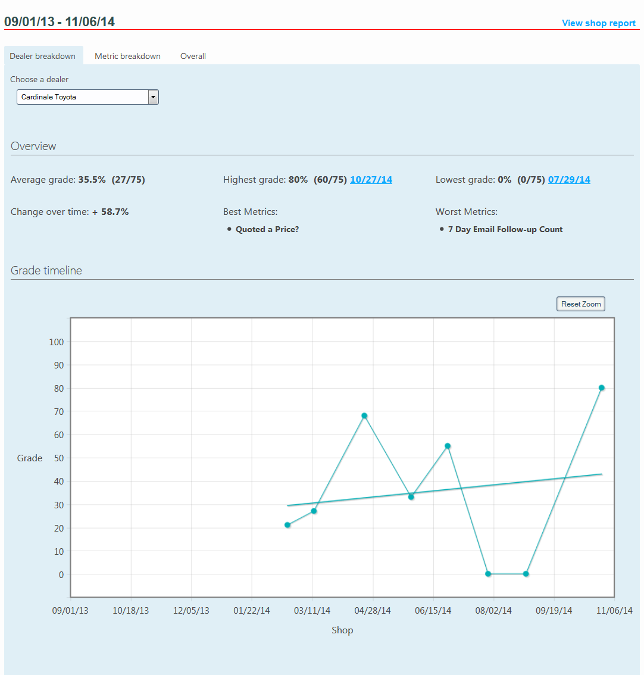
Composite Report
Our composite report allows you to choose a date range to view changes over time to your strategy, or a competitor’s strategy.
Dealer Grades Breakdown
Select a custom date range, and then view the performance for any dealer in a shop, including their average, highest and lowest grades, their strengths and weaknesses, and the change in their performance over time.

Slide 11
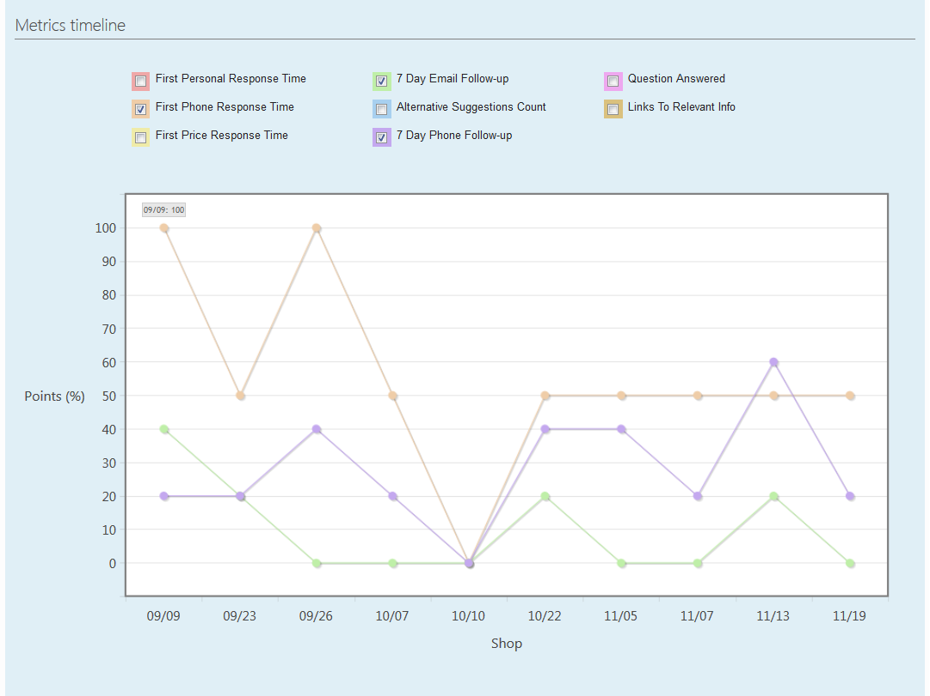
Composite Report
Our composite report allows you to choose a date range to view changes over time to your strategy, or a competitor’s strategy.
Metrics Timeline
Use our default date range, or select a custom range, and then view a line graph of performance over time for one or more of your metrics for any dealer in the shop.

Slide 12
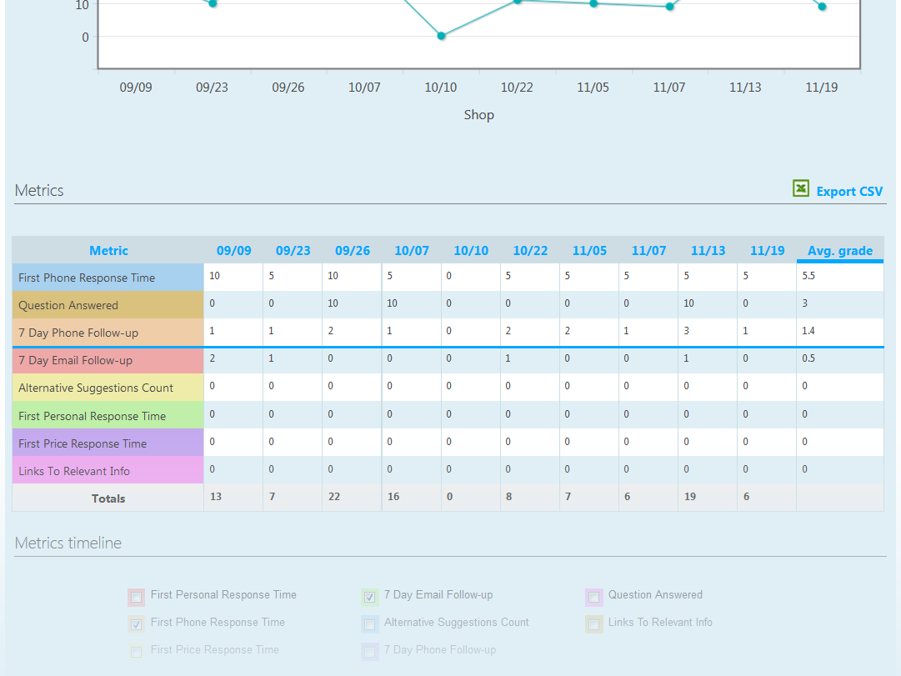
Composite Report
Our composite report allows you to choose a date range to view changes over time to your strategy, or a competitor’s strategy.
Graded Metrics Breakdown
We also provide you with a color-coded chart of metrics grades by date, including totals and averages for each metric. All of our charts can be exported as Comma Separated Values (CSV) files, so you can import the data into your own spreadsheets for further analysis.

Slide 13

Are you on target?
By observing your competitors’ actual interactions with customers, you can gain critical insights into their strategies, and refine your own strategy. The rapidly evolving sphere of Automotive Digital Marketing requires active research into changing systems, practices, and customer behavior. Stealth Shopper is a powerful tool that allows you to read and analyze exactly what your competitors say to their customers, so you can identify market changes and take advantage of them before they disappear.

